Slide 1


Default of Credit Card Clients data set Predictive Modeling Project
Submitted by: Team – 5

Slide 2

Project analysis slide 2
Contents
Problem Statement
Results
The Process
Conclusions &
Recommendations
Methodology
Appendix

Slide 3



Problem Statement
This research is aimed at the case of customers default payments in Taiwan. Given the last six months of payment history, the goal of the project is to forecast the probability of default credit card payment for the following month.
From the perspective of risk management, the result of predictive accuracy of “defaults” will be more valuable than the total accuracy of the model.

Slide 4

The Process
WHY?
Banks and financial institutions can use this model to target their ideal credit card customer by analyzing the potential customer profiles.
We start by cleaning the data by performing basic data treatment procedures like checks for outliers and missing values.
New variables were created by feature engineering method which reduces the complexity from 13 variables (related to payment history and credit limit) down to 2.
The bivariate analysis between independent variables and target variable also helped in identifying some interesting relations.
Different modeling techniques like Logistic regression, Decision tree, Neural networks, and KNN are performed on the cleaned dataset
HOW?

Slide 5


Project analysis slide 3
Methodology
SAMPLE
EXPLORE
MODIFY
MODEL
ASSESS
This stage consists of sampling the data by extracting a portion of a large data set big enough to contain the significant information
Includes outlier analysis, analyzing missing values
Also captures exploration of relationship between predictor variables and target variable
We conducted feature engineering by creating new variables for capturing data and facilitating variable reduction
Fixed outliers
Ran predictive models on the cleaned and modified data set
Configured each model specifically to generate good predictive accuracy
Comparing results from each model to evaluate the best models
Running ensembles to combine good performing models for possible best accuracy

Slide 6
Project analysis slide 3
Sampling
The data selected is a “Default of Credit Card Clients data set”
In this data set, we have 30,000 rows and 24 attributes which include - personal information (like gender, education, marital status & age) and payment information of customers (like limit balance, number of delays in months and bill amount & previous payments from August to September).
Attribute Details:
SAMPLE
This stage consists of sampling the data by extracting a portion of a large data set big enough to contain the significant information
Personal Information
Payment Information
X1: Credit Limit
X2: Gender
X3: Education
X4: Marital status
X5: Age (year).
X6 = the repayment status in September 2005
X7 = the repayment status in August 2005.
X11 = the repayment status in April 2005.
X12-X17: Amount of bill statement
X18-X23: Amount of previous payment
Source – UC Irvine Archives

Slide 7
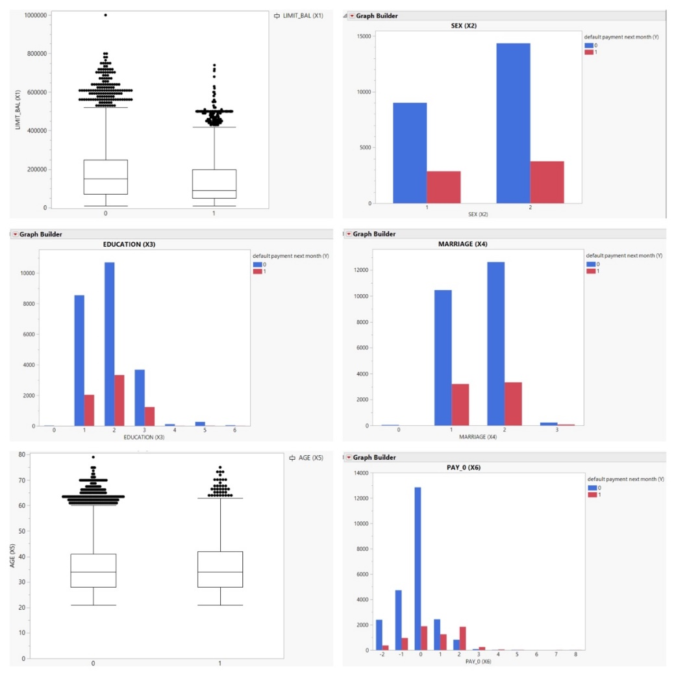
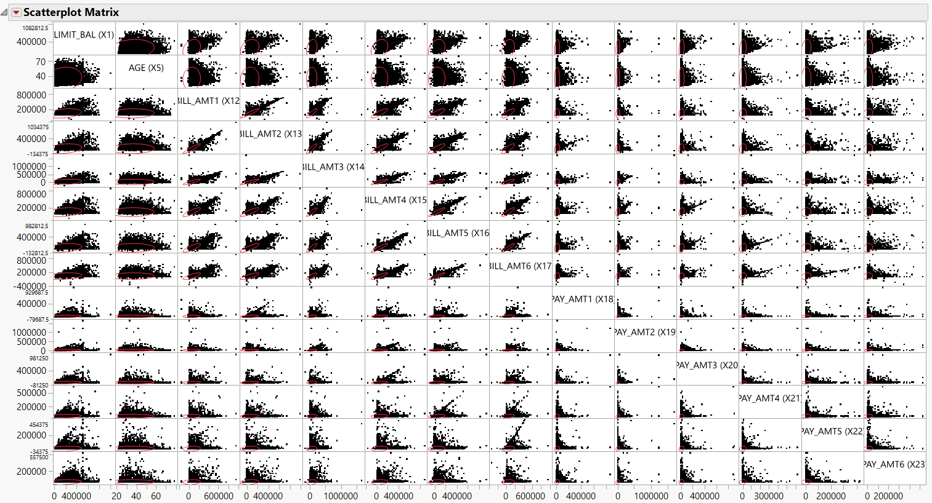
Project analysis slide 3
Exploration (Illustration)
EXPLORE
Includes outlier analysis, analyzing missing values
Also captures exploration of relationship between predictor variables and target variable

Slide 8
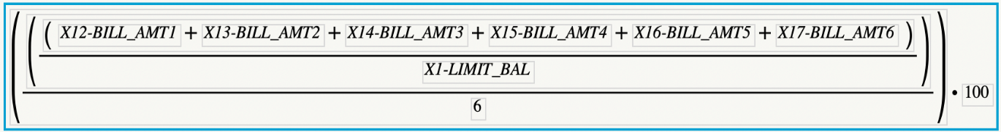
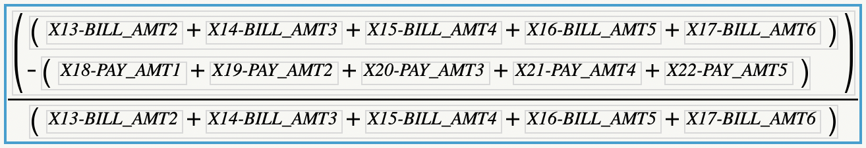
Project analysis slide 3
Modify (Illustration)
Credit Utilization
MODIFY
Remaining Payment %
We conducted feature engineering by creating new variables for capturing data and facilitating variable reduction
Fixed outliers
STRATIFICATION SPLIT BALANCED
OUTLIERS
For reducing biasness of 0s in the data set

Slide 9



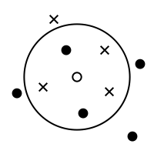

Project analysis slide 3
Model
Logistic Regression
Decision Tree
Neural Network
MODEL
Bootstrap Forest
Boosted Tree
Ran predictive models on the cleaned and modified data set
Configured each model specifically to generate good predictive accuracy
KNN
Naïve Bayes
We didn’t proceed with Stratification Split Balanced (SSB) method as an improved accuracy of 1 performance was not observed. Additionally, not using SSB restored our sample size to 30k records (up from ~15k) which essentially is better for training models.

Slide 10
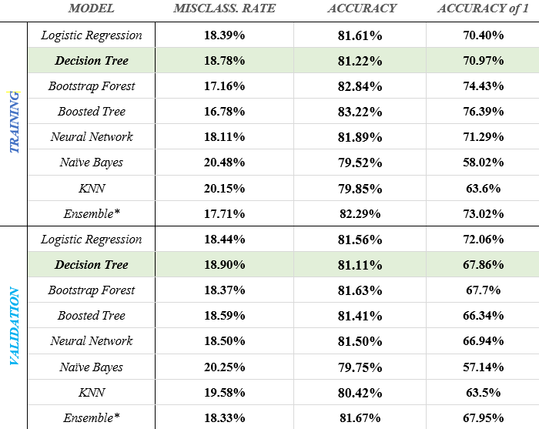
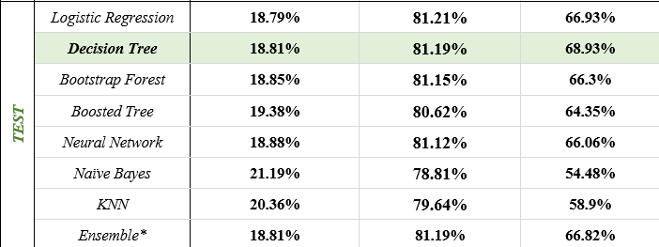
Project analysis slide 3
ASSESSMENT
ASSESS
Comparing results from each model to evaluate the best models
Running ensembles to combine good performing models for possible best accuracy

Slide 11
Project analysis slide 10
Assessment - Validation
Logistic Regression performs the best amongst the models with Total Accuracy = 81.6%)
Logistic Regression performs the best amongst the models with an Accuracy of 1 = 72.1%)
For the validation window, LOGISTIC REGRESSION performs the best across both Total Accuracy and Accuracy of 1

Slide 12
Project analysis slide 10
Assessment - Test
Logistic Regression performs the best amongst the models with Total Accuracy = 81.21%)
Decision Tree performs the best amongst the models with an Accuracy of 1 = 68.93%)
For the test window, DECISION TREE performs the best across models for the Accuracy of 1 [No. of defaults]

Slide 13
Project analysis slide 8
Results – Best two models
We shortlisted the best two models and compared their performance metrics and from a business sense.
DECISION TREE
ENSEMBLE
Misclassification Rate = 18.81%
Total Accuracy = 81.19%
Accuracy of 1 = 68.93%
Misclassification Rate = 18.81%
Total Accuracy = 81.19%
Accuracy of 1 = 66.82%
METRICS
The decision tree performed almost at par with the best ensemble version in terms of Total Accuracy and misclassification rate
However, the decision tree performed significantly better on the Accuracy of 1 by a margin of +2.1%
Ensemble performed better (very slightly) than the decision tree in terms of Total Accuracy
Ensemble lost on the accuracy of 1 performance owing to averaging out across multiple predictive models.
INFERENCES
DECISION TREE is the recommended model for the “DEFAULTS in CREDIT CARD PAYMENTS” data set

Slide 14
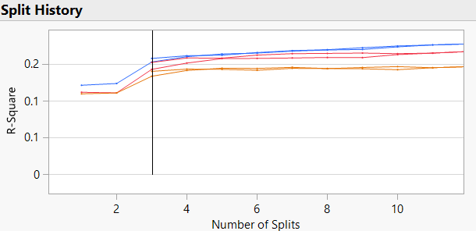
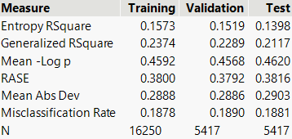
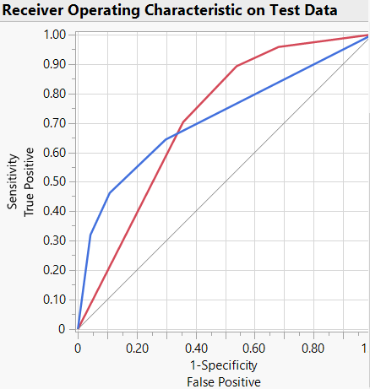
Project analysis slide 8
Best Model – Decision Tree
After comparing the performance metrics, Decision Tree was chosen as the best model for this exercise
CONFIGURATION
FIT DETAILS & ROC
Predictor Variables (X): X1 – Limit_Bal, X2 – Sex, X3 – Education, X4 – Marriage, X5 – AGE, X6 – Pay_0 to X11 – Pay_6, Cred_Utilization, Remaining Payment %
Target Variable (Y): “Y Default payment next month“ [CATEGORICAL]
Number of splits: 3 (Pruned down from 24)
The default model configured the “No of splits = 24”. However, we observed that the added complexity did not add to the performance, and hence, we pruned it down to 3 splits i.e., the last kink in the R-square plot. Incidentally, we not only reduced the complexity drastically, but saw an improvement in the total accuracy and the accuracy of 1.
Complexity for the DECISION TREE model was brought down by ~88% - Accuracy of 1 remains the highest across all models

Slide 15
Project analysis slide 8
Conclusions & Recommendations
Key Takeaways:
Recommendations:
A higher credit utilization was directly related to a customer defaulting on their credit card payment for the following month
High correlation between the education level and the chances of customers defaulting on their credit card.
Remaining payment percentage -> Avg. percentage of the bill amounts left to be paid back by the individual.
Remaining payment percentage is directly proportional to the likelihood of defaulting on the credit card payment for next month
In the case of existing customers, the following steps can be taken:
If (credit utilization = high) -> The customers should be warned of the effect on the CIBIL scores and future loan opportunities
The customer’s limit_bal should be reduced if there is a trend of high credit utilization every month
From the perspective of acquiring new customers, the below recommendation can be made:
Personal background of a potential customer like their education level can be evaluated before a decision on limit or issuance of their credit card
Spending patterns, personal information facilitates better decisions on credit card issuance for a reduction in defaulting risk

Slide 16
Appendix

Slide 17
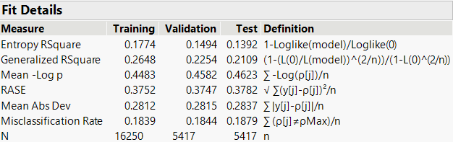
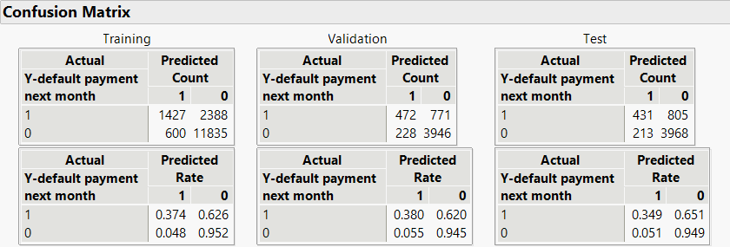
Regression – Nominal Logistic

Slide 18
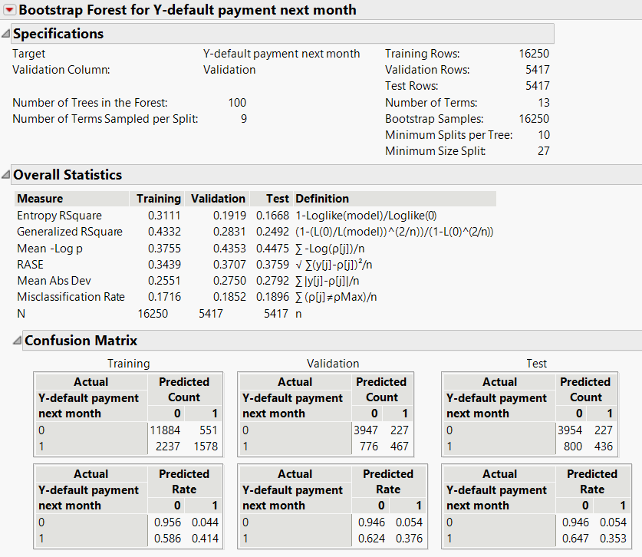
Bootstrap Forest

Slide 19
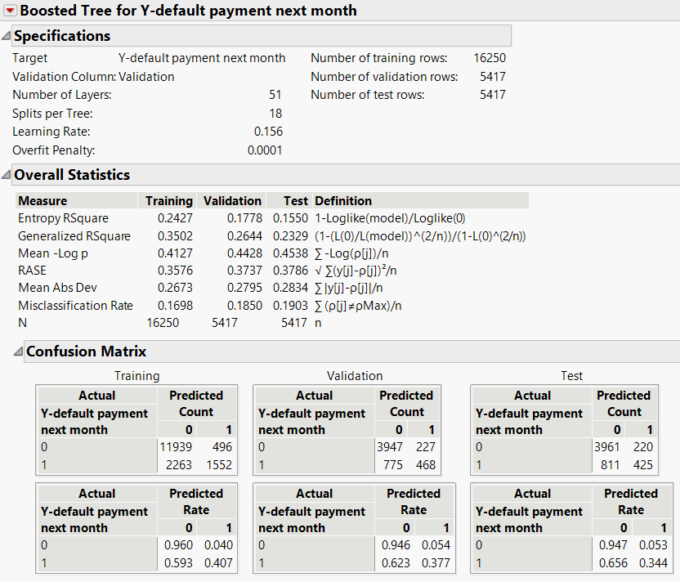
Boosted Tree

Slide 20
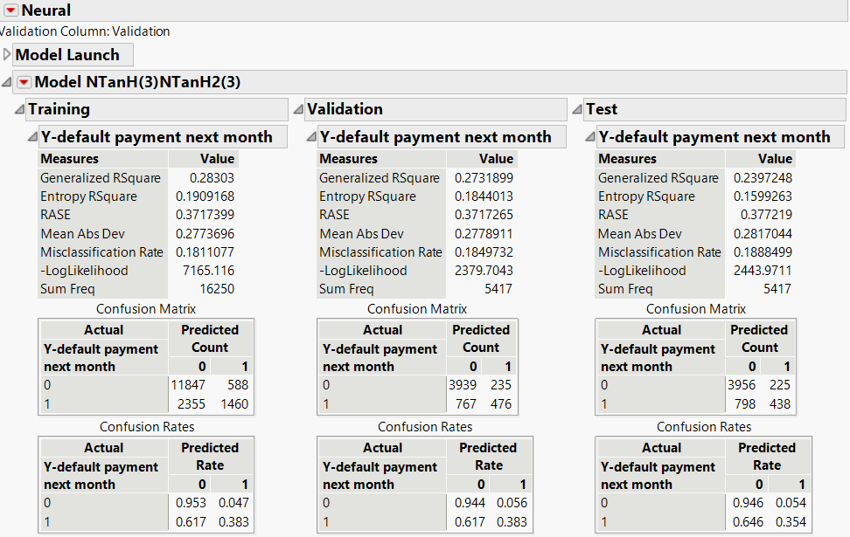
Neural Network – 3TanH1 3TanH2

Slide 21
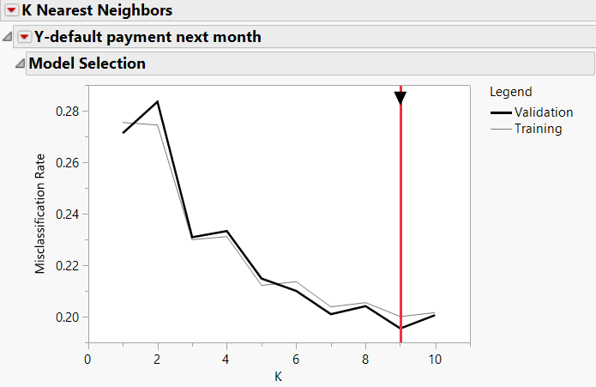
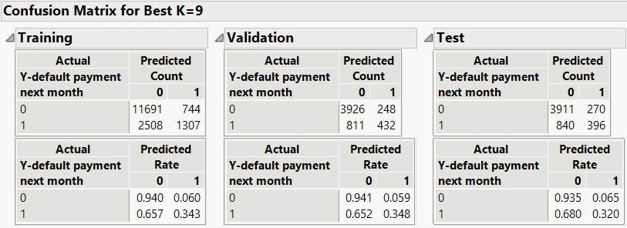
K-nearest neighbors

Slide 22
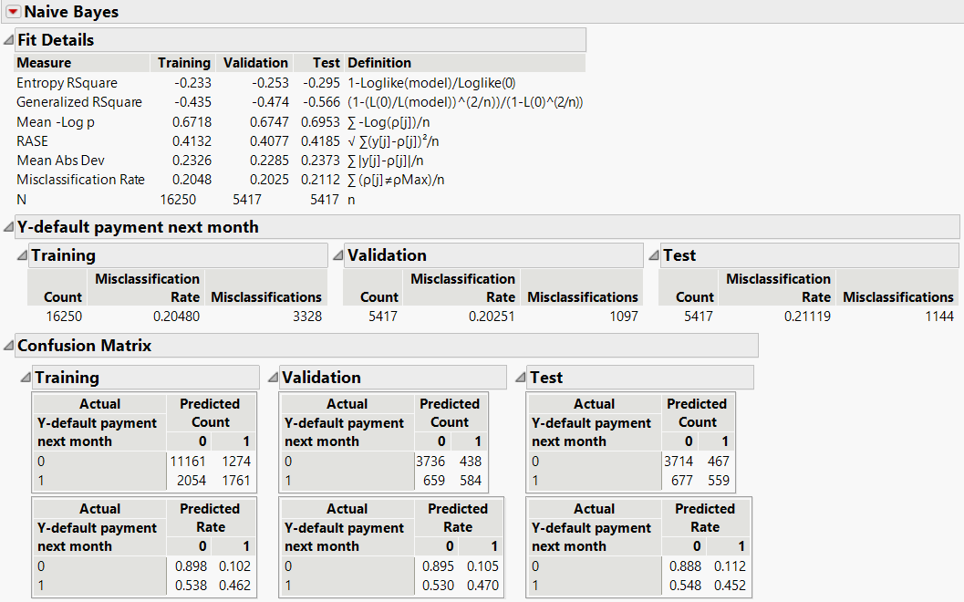
Naïve Bayes

Slide 23
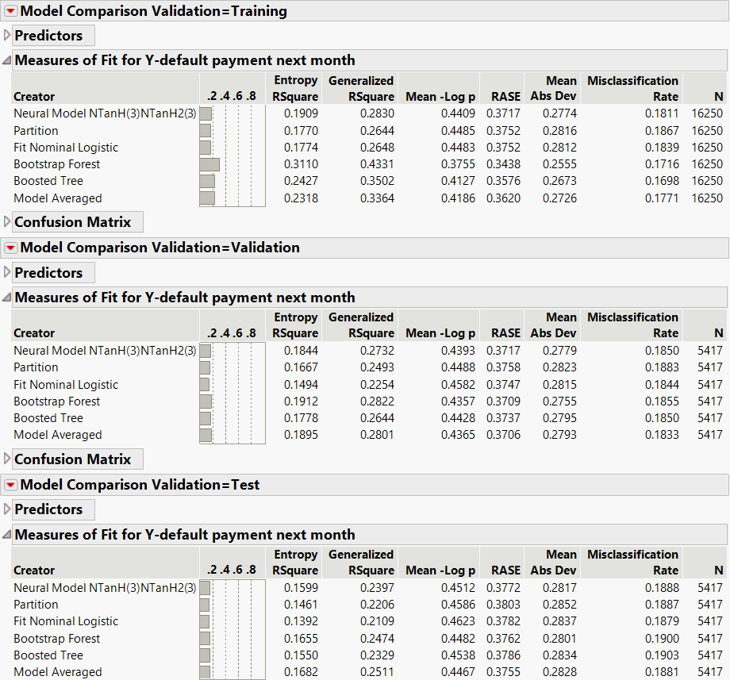
Ensemble - Screenshots

Slide 24
Thank You

